Slide 1
Module - 4
(Network Layer in the Internet)

Slide 2
IP protocol, IP addresses, Internet Control Message Protocol (ICMP), Address Resolution Protocol (ARP), Reverse Address Resolution Protocol (RARP), Bootstrap Protocol (BOOTP),Dynamic Host Configuration Protocol (DHCP). Open Shortest Path First(OSPF) Protocol,Border Gateway Protocol (BGP), Internet multicasting, IPv6, ICMPv6.

Slide 3
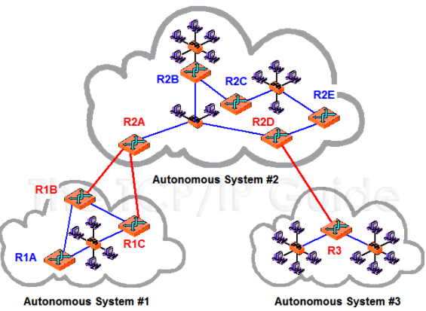
Internet Routing Protocols
An autonomous system (AS) is a group of networks and routers under the authority of a single administration.
Routing inside an autonomous system is called intra-domain routing.
Routing between autonomous systems is called inter-domain routing
Autonomous Systems (AS) - Characteristics:
An AS consists of group of routers
exchanging information via common
routing protocol.
An AS is a set of routers and networks
managed by single organization.
Fig:Autonomous System (AS) Routing Architecture

Slide 4
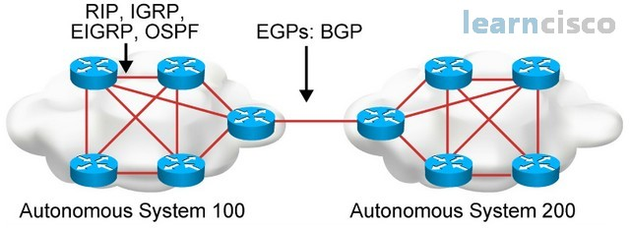
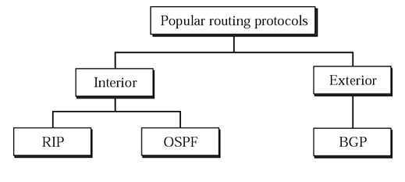
Routing Protocols
Interior Routing Protocols
Exterior Routing Protocols

Slide 5
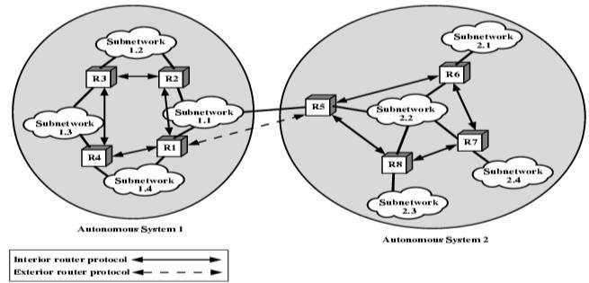
Interior Routing Protocol (IRP)
Passes routing information between routers within AS.
Does not need to be implemented outside of the AS.
Allows IRP to be custom tailored to specific applications and requirements.
All of the LANs at a site Form an AS.

Slide 6
This system might be linked through a WAN to other ASs.
May be different algorithms and routing information in different connected AS.
Routers need minimum information from other connected AS.

Slide 7
Exterior Routing Protocol (ERP)
Protocol used to pass routing information between routers in different ASes.
Pass less information than Interior routing protocol.
ERP does not deal with details within target AS
If a datagram is to be transferred from a host in one AS to a host in another AS.
Router in first system determines route to target AS.
Routers in target AS then co-operate to deliver datagram.

Slide 8
Interior Routing Protocols
RIP
OSPF

Slide 9
Routing Information Protocol (RIP)
A simple intra domain protocol
Straightforward implementation of Distance Vector Routing
Each router advertises its distance vector every 30 seconds to all of its neighbors
RIP always uses 1 as link metric
Maximum hop count is 15.
Routes are timeout (set to 16) after 3 minutes if they are not updated

Slide 10
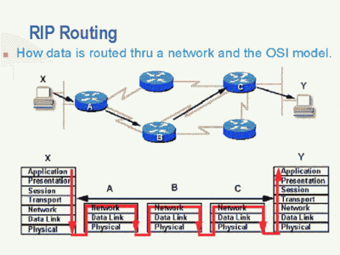

Slide 11
RIP messages
Request
A request message is sent by a router that has just come up or by a router that has some time-out entries
A request can ask about specific entries or all entries
Response
A response can be either solicited (ask for a proposal) or unsolicited (30s or when there is a change in the routing table)
RIP Timers
Periodic timer
It controls the advertising of regular update message (25 ~ 30 sec)
Expiration timer
It governs the validity of a route (180 sec)
The route is considered expired and the hop count of the route is set to 16
Garbage collection timer
An invalid route is not purged(remove that not in use) from the routing table until this timer expires (120 sec)

Slide 12
In brief the RIP protocol works as follows:
• Each router initializes its routing table with a list of locally connected networks. Periodically, each router advertises the entire contents of its routing table over all of its RIP-enabled interfaces.
• Whenever a RIP router receives such an advertisement, it puts all of the appropriate routes into its routing table and begins using it to forward packets. This process ensures that every network connected to every router eventually becomes known to all routers.
• If a router does not continue to receive advertisements for a remote route, it eventually times out that route and stops forwarding packets over it.

Slide 13
Every route has a property called a metric, which indicates the "distance" to the route's destination.
Every time a router receives a route advertisement, it increments the metric.
The maximum metric permitted by RIP is 16, which means that a route is unreachable. Ie., the protocol cannot scale to networks more than 15 hops to a given destination.
RIP also includes some optimizations of this basic algorithm to improve stabilization of the routing database and to eliminate routing loops.
When a route is determined to be unreachable, RIP routers do not delete it straightaway. Instead they continue to advertise the route with a metric of 16 (unreachable).
A "Request" message allows a newly-started router to rapidly query all of its neighbours’ routing tables.

Slide 14
RIP Packet Format
RIP messages uses UDP datagrams
Size of datagram limited to 512 bytes (allow advertisement of 25 routes.
Command: 8 bits
Request (1), reply (2)
Version: 1 or 2
Family: of protocol used for TCP/IP it is 2
Network address : 32 bytes
Distance: hop count from the advertising router to the destination network
Response: solicited or unsolicited

Slide 15
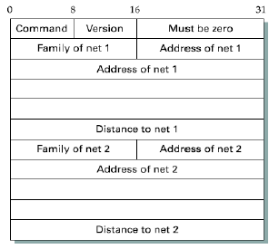

Slide 16
RIP Problems
RIP takes a long time to stabilize
Even for a small network, it takes several minutes until the routing tables have settled after a change
RIP has all the problems of distance vector algorithms, e.g., count-to-Infinity
The maximum path in RIP is 15 hops

Slide 17
Routing Algorithms - OSPF
The original Internet interior gateway protocol was a distance vector protocol (RIP) based on the Bellman-Ford algorithm inherited from the ARPANET.
It worked well in small systems but less well as ASes got larger.
It also suffered from the count-to-infinity problem and generally slow convergence
So it was replaced in May 1979 by a link state protocol.
In 1988, the Internet Engineering Task Force (IETF) began work on a successor.
That successor, called OSPF (Open Shortest Path First), became a standard in 1990.
Most router vendors now support it, and it has become the main interior gateway protocol.

Slide 18
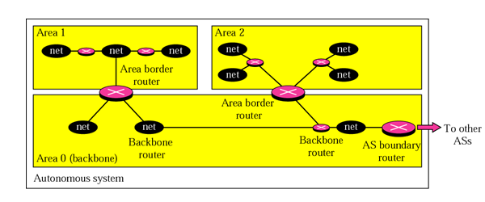
OSPF (Open Shortest Path First) protocol
The OSPF (Open Shortest Path First) protocol is one of a family of IP Routing protocols and is an Interior Gateway Protocol (IGP) for the Internet, used to distribute IP routing information throughout a single Autonomous System (AS) in an IP network.
The Open Shortest Path First (OSPF) protocol is an intra-domain routing protocol based on link state routing.

Slide 19
OSPF (Open Shortest Path First) protocol
Divides an AS into areas
Special routers (autonomous system boundary routers) or backbone routers responsible to dissipate(disappear) information about other AS into the current system.
Metric based on type of service : Minimum delay , maximum throughput, reliability, etc.

Slide 20
Routing Algorithms - OSPF
List of features that had to be met by OSPF algorithm
It had to be published in the open literature, hence the ''O'' in OSPF
It had to support a variety of distance metrics, including physical distance, delay, and so on
It had to be a dynamic algorithm, one that adapted to changes in the topology automatically and quickly
It had to support routing based on type of service (TOS)
Ability to route real-time traffic one way and other traffic a different way
but no existing routing protocol used it & it was eventually removed

Slide 21
Routing Algorithms - OSPF
It had to do load balancing, splitting the load over multiple lines.
Most previous protocols sent all packets over the best route.
The second-best route was not used at all.
In many cases, splitting the load over multiple lines gives better performance
Support for hierarchical systems was needed.
Some degree of security was required to prevent sending false routing information to routers.
Provision was needed for dealing with routers that were connected to the Internet via a tunnel.

Slide 22
Routing Algorithms - OSPF
OSPF supports three kinds of connections and networks:
1. Point-to-point lines between exactly two routers.
2. Multiaccess networks with broadcasting (e.g., most LANs).
3. Multiaccess networks without broadcasting (e.g., most packet-switched WANs).
A multiaccess network is one that can have multiple routers on it, each of which can directly communicate with all the others.
All LANs and WANs have this property.

Slide 23
Routing Algorithms - OSPF
OSPF operates by abstracting the collection of actual networks, routers, and lines into a directed graph in which each arc is assigned a cost (distance, delay, etc.).
It then computes the shortest path based on the weights on the arcs.
A serial connection between two routers is represented by a pair of arcs, one in each direction.
Their weights may be different.
A multiaccess network is represented by a node for the network itself plus a node for each router.
What OSPF fundamentally does is
To represent the actual network as a graph like this and then compute the shortest path from every router to every other router.

Slide 24
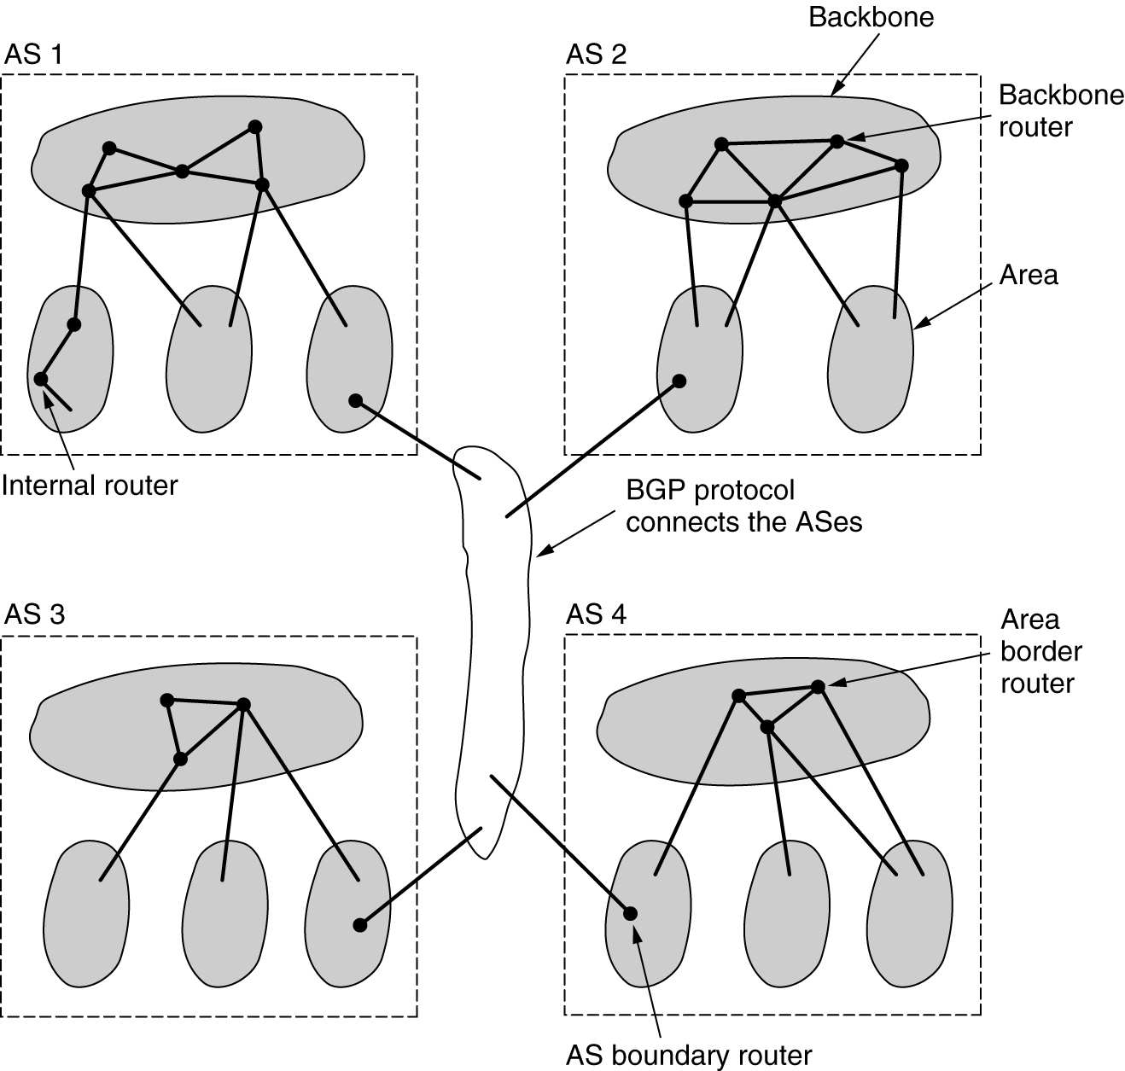
OSPF
The relation between ASes, backbones, and areas in OSPF.

Slide 25
Routing Algorithms - OSPF
Many of the ASes in the Internet are themselves large and nontrivial to manage.
OSPF allows them to be divided into numbered areas, where an area is a network or a set of contiguous networks.
Areas do not overlap but need not be complete, that is, some routers may belong to no area.
An area is a generalization of a subnet.
Outside an area, its topology and details are not visible.
Every AS has a backbone area, called area 0.
All areas are connected to the backbone, possibly by tunnels
So it is possible to go from any area in the AS to any other area in the AS via the backbone.
A tunnel is represented in the graph as an arc and has a cost.
Each router that is connected to two or more areas is part of the backbone.

Slide 26
Routing Algorithms - OSPF
Within an area, each router has the same link state database and runs the same shortest path algorithm.
Its main job is to calculate the shortest path from itself to every other router in the area, including the router that is connected to the backbone.
A router that connects to two areas needs the databases for both areas and must run the shortest path algorithm for each one separately.
During normal operation, three kinds of routes may be needed:
intra-area,
interarea, and
inter-AS.

Slide 27
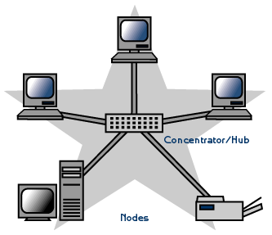
Routing Algorithms - OSPF
Intra-area routes are the easiest, since the source router already knows the shortest path to the destination router.
Interarea routing always proceeds in three steps:
Go from the source to the backbone;
Go across the backbone to the destination area;
Go to the destination.
This algorithm forces a star configuration on OSPF with the backbone being the hub and the other areas being spokes.

Slide 28
Routing Algorithms - OSPF
OSPF distinguishes four classes of routers:
1. Internal routers are wholly within one area.
2. Area border routers connect two or more areas.
3. Backbone routers are on the backbone.
4. AS boundary routers talk to routers in other ASes.
These classes are allowed to overlap.
For example, all the border routers are automatically part of the backbone.
In addition, a router that is in the backbone but not part of any other area is also an internal router.

Slide 29
Routing Algorithms - OSPF
Working:
When a router boots, it sends HELLO messages on all of its point-to-point lines and multicasts them on LANs to the group consisting of all the other routers.
From the responses, each router learns who its neighbors are.
Routers on the same LAN are all neighbors.
OSPF works by exchanging information between adjacent routers
In particular, it is inefficient to have every router on a LAN talk to every other router on the LAN.
To avoid this situation, one router is elected as the designated router.
It is said to be adjacent to all the other routers on its LAN, and exchanges information with them.

Slide 30
Routing Algorithms - OSPF
Neighboring routers that are not adjacent do not exchange information with each other.
A backup designated router is always kept up to date to ease the transition if the primary designated router crash and need to be replaced immediately.
During normal operation, each router periodically floods LINK STATE UPDATE messages to each of its adjacent routers.
This message gives its state and provides the costs used in the topological database.
The flooding messages are acknowledged, to make them reliable.
Each message has a sequence number, so a router can see whether an incoming LINK STATE UPDATE is older or newer than what it currently has.
Routers also send these messages when a line goes up or down or its cost changes.

Slide 31
Routing Algorithms - OSPF
DATABASE DESCRIPTION messages give the sequence numbers of all the link state entries currently held by the sender.
By comparing its own values with those of the sender, the receiver can determine who has the most recent values.
These messages are used when a line is brought up.
Either side can request link state information from the other one by using LINK STATE REQUEST messages.
The result of this algorithm is that each pair of adjacent routers checks to see who has the most recent data, and new information is spread throughout the area this way.
All these messages are sent as raw IP packets.
The five kinds of messages are summarized in the following table

Slide 32
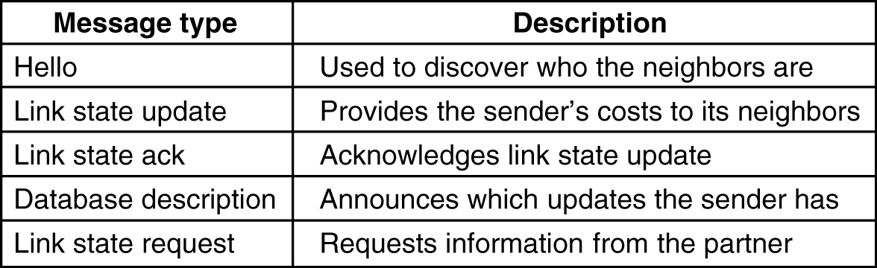
OSPF
The five types of OSPF messages.

Slide 33
Routing Algorithms - OSPF
Summary:
Using flooding, each router informs all the other routers in its area of its neighbors and costs.
This information allows each router to construct the graph for its area(s) and compute the shortest path.
The backbone area does this too.
In addition, the backbone routers accept information from the area border routers in order to compute the best route from each backbone router to every other router.
This information is propagated back to the area border routers, which advertise it within their areas.
Using this information, a router about to send an interarea packet can select the best exit router to the backbone.

Slide 34
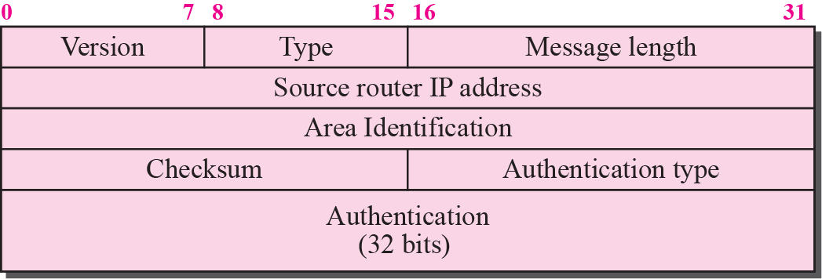
OSPF Packet format :
Version: version of the OSPF
Type : It specifies the type of the packets, there are 4 types of packets
* hello packet
* link state request
* link state update
* Link state acknowledgement
Source address :It defines the address of the node to be send.
Area id : It specifies ID of different areas
Check sum :It deals with error detection and correction
Authentication type :It has two value either zero or other numbers except zero
Authentication data: used by authentication procedure

Slide 35
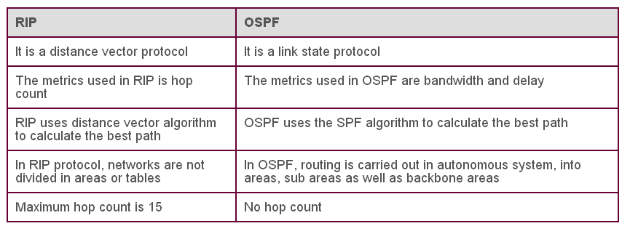
Comparison of RIP and OSPF

Slide 36
Exterior Gateway Routing Protocol - BGP
Border Gateway Protocol (BGP) refers to a gateway protocol that enables the internet to exchange routing information between autonomous systems (AS).
As networks interact with each other, they need a way to communicate.
This is accomplished through peering.
Without it, networks would not be able to send and receive information with each other.

Slide 37
How Does BGP Work?
When you have a network router that connects to other networks, it does not know which network is the best one to send its data to.
BGP takes into consideration all the different peering options a router has and chooses the one closest to where the router is.
Each potential peer communicates the routing information it has and that gets stored within a routing information base (RIB).
BGP can access this information and use it to choose the best peering option.

Slide 38
Exterior Gateway Routing Protocol - BGP

Slide 39
Exterior Gateway Routing Protocol - BGP
Exterior gateway protocols in general, and BGP in particular, have been designed to allow many kinds of routing policies to be enforced in the interAS traffic
Typical policies involve political, security, or economic considerations.
A few examples of routing constraints are
No transit traffic through certain ASes
Traffic starting or ending at IBM should not transit Microsoft

Slide 40
Exterior Gateway Routing Protocol - BGP
Given BGP's special interest in transit traffic, networks are grouped into one of 3 categories.
Category 1: stub networks
which have only one connection to the BGP graph.
cannot be used for transit traffic because there is no one on the other side.
Category 2: multiconnected networks
could be used for transit traffic, except that they refuse.
Category 3: transit networks
such as backbones, which are willing to handle third-party packets
possibly with some restrictions, and usually for pay

Slide 41
Exterior Gateway Routing Protocol - BGP
Pairs of BGP routers communicate with each other by establishing TCP (Transmission Control Protocol) connections.
Operating this way provides reliable communication and hides all the details of the network being passed through.
BGP is fundamentally a distance vector protocol
Instead of maintaining just the cost to each destination, each BGP router keeps track of the path used.
Similarly, instead of periodically giving each neighbor its estimated cost to each possible destination, each BGP router tells its neighbors the exact path it is using

Slide 42
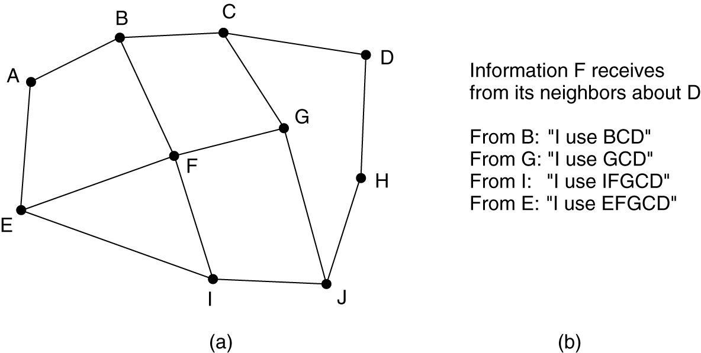
BGP – The Exterior Gateway Routing Protocol
(a) A set of BGP routers. (b) Information sent to F.

Slide 43
Exterior Gateway Routing Protocol - BGP
consider F's routing table.
Suppose that it uses the path FGCD to get to D.
When the neighbors give it routing information, they provide their complete paths
After all the paths come in from the neighbors, F examines them to see which is the best.
It quickly discards the paths from I and E, since these paths pass through F itself.
The choice is then between using B and G.
Every BGP router contains a module that examines routes to a given destination and scores them, returning a number for the ''distance'' to that destination for each route.

Slide 44
Exterior Gateway Routing Protocol - BGP
BGP easily solves the count-to-infinity problem
For example, suppose G crashes or the line FG goes down.
F then receives routes from its three remaining neighbors. These routes are BCD, IFGCD, and EFGCD.
It can immediately see that the two latter routes are pointless, since they pass through F itself, so it chooses FBCD as its new route.

Slide 45
Design Principles for Internet
Make sure it works.
Keep it simple.
Make clear choices.
Exploit modularity.
Expect heterogeneity.
Avoid static options and parameters.
Look for a good design; it need not be perfect.
Be strict when sending and tolerant when receiving.
Think about scalability.
Consider performance and cost.

Slide 46
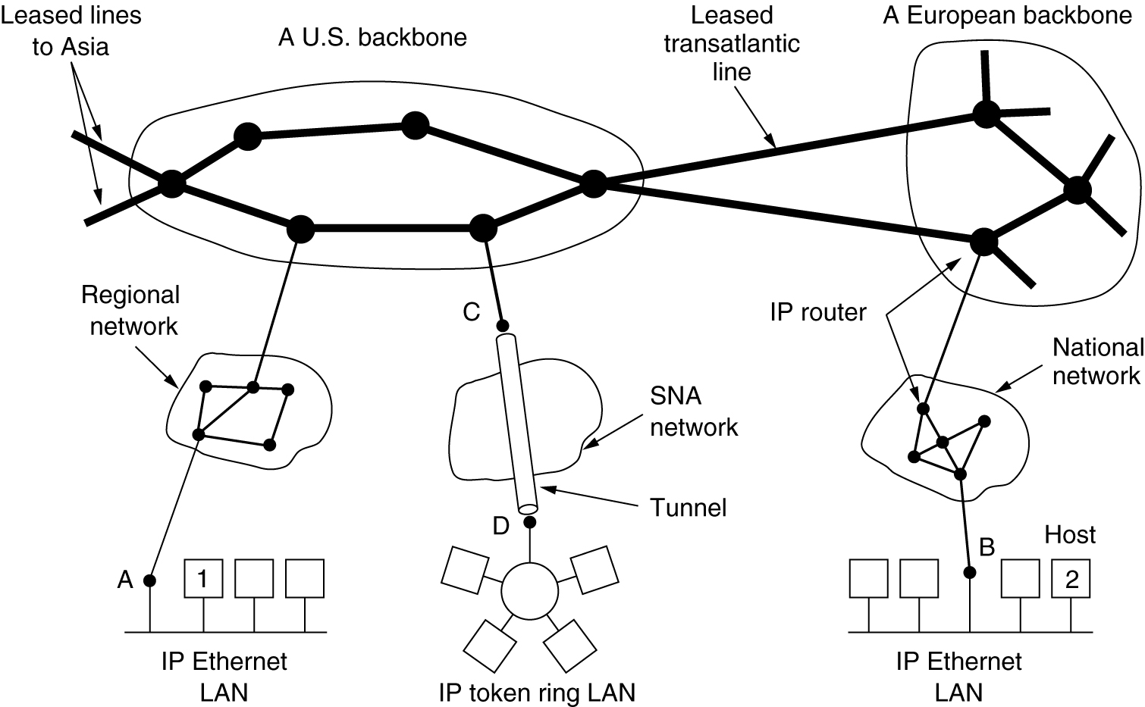
Collection of Subnetworks
The Internet is an interconnected collection of many networks.

Slide 47
IP (Internet Protocol)
The glue that holds the whole Internet together is the network layer protocol, IP (Internet Protocol).
Unlike most older network layer protocols, IP was designed from the beginning with internetworking in mind.
It transport packets from source to destination, without regard to whether these machines are on the same network or whether there are other networks in between them.

Slide 48
IP (Internet Protocol)
Communication in the Internet works as follows.
The transport layer takes data streams and breaks them up so that they may be sent as IP packets.
In theory, packets can be up to 64 KB each, but in practice they are usually not more than 1500 bytes (so they fit in one Ethernet frame).
IP routers forward each packet through the Internet, along a path from one router to the next, until the destination is reached.
At the destination, the network layer hands the data to the transport layer, which gives it to the receiving process.
When all the pieces finally get to the destination machine, they are reassembled by the network layer into the original datagram.
This datagram is then handed to the transport layer

Slide 49
The IP version 4 Protocol
An IPv4 datagram consists of a header part and a body or payload part.
The header has a 20-byte fixed part and a variable-length optional part.
The bits are transmitted from left to right and top to bottom, with the high-order bit of the Version field going first.

Slide 50
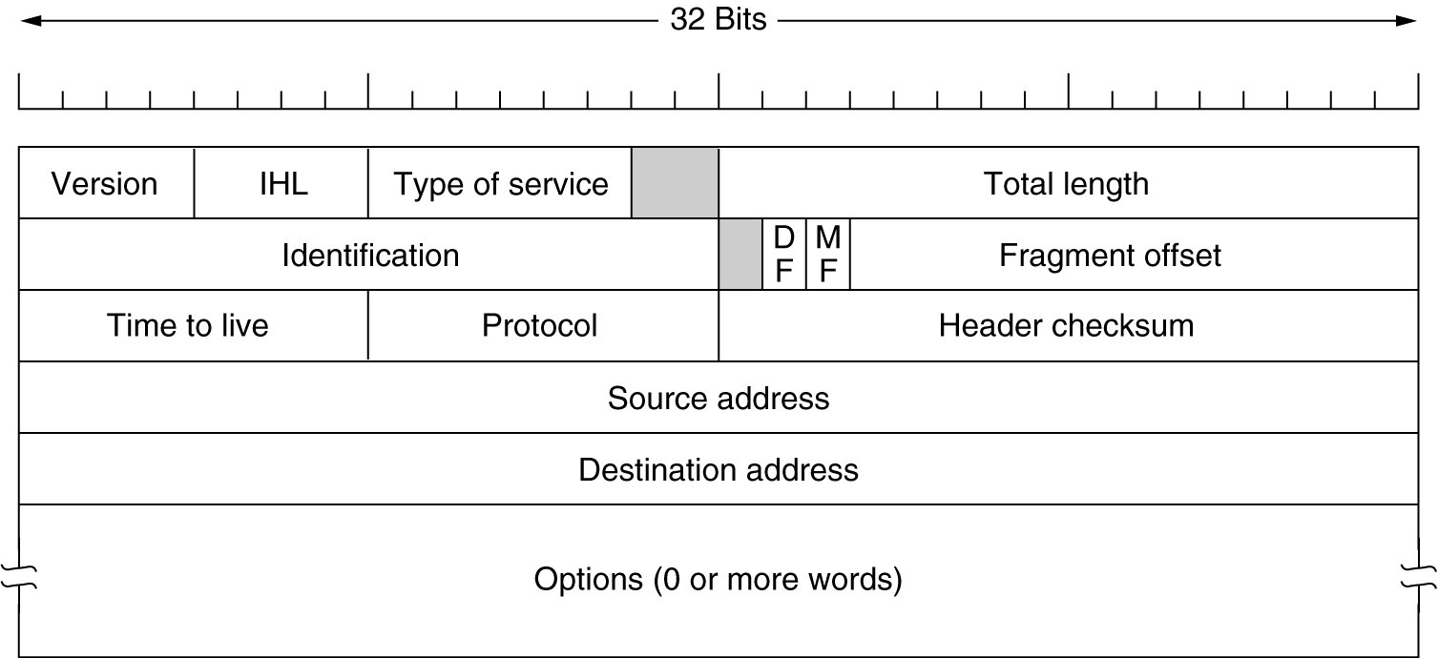
The IP Protocol
The IPv4 (Internet Protocol) header.

Slide 51
The IP Protocol
Version field
keeps track of which version of the protocol the datagram belongs to.
Currently a transition between IPv4 and IPv6 is going on
IPv5 was an experimental real-time stream protocol that was never widely used
IHL field
Since the header length is not constant, IHL is provided to tell how long the header is, in 32-bit words.
The minimum value is 5, which applies when no options are present.
The maximum value of this 4-bit field is 15, which limits the header to 60 bytes, and thus the Options field to 40 bytes.

Slide 52
The IP Protocol
Type of service field.
to distinguish between different classes of service
Various combinations of reliability and speed are possible.
For digitized voice, fast delivery beats accurate delivery.
For file transfer, error-free transmission is more important than fast transmission.
6-bit field contained a three-bit Precedence field and three flags, D, T, and R.
The Precedence field was a priority from 0 (normal) to 7 (network control packet)
The three flag bits allowed the host to specify from the set {Delay, Throughput, Reliability}
Current routers often ignore the Type of service field altogether

Slide 53
The IP Protocol
Total length field
includes everything in the datagram—both header and data.
The maximum length is 65,535 bytes.
At present, this upper limit is tolerable, but with future gigabit networks, larger datagrams may be needed
Identification field
needed to allow the destination host to determine which datagram a newly arrived fragment belongs to.
All the fragments of a datagram contain the same Identification value.

Slide 54
The IP Protocol
two 1-bit fields: DF & MF
DF stands for Don't Fragment.
It is an order to the routers not to fragment the datagram because the destination is incapable of putting the pieces back together again.
the datagram must avoid a small-packet network on the best path and take a suboptimal route.
MF stands for More Fragments.
All fragments except the last one have this bit set.
It is needed to know when all fragments of a datagram have arrived

Slide 55
The IP Protocol
Fragment offset field:
tells where in the current datagram this fragment belongs.
All fragments except the last one in a datagram must be a multiple of 8 bytes, the elementary fragment unit.
Time to live field
counter used to limit packet lifetimes.
It is supposed to count time in seconds, allowing a maximum lifetime of 255 sec.
It must be decremented on each hop
It is supposed to be decremented multiple times when queued for a long time in a router.

Slide 56
The IP Protocol
In practice, it just counts hops.
When it hits zero, the packet is discarded and a warning packet is sent back to the source host.
This feature prevents datagrams from wandering around forever
Protocol field
tells it which transport process to give it to.
Possibilities are TCP, UDP and some others.
The numbering of protocols is global across the entire Internet.

Slide 57
The IP Protocol
Header checksum field
verifies the header only.
Such a checksum is useful for detecting errors generated by bad memory words inside a router.
The algorithm is to add up all the 16-bit halfwords as they arrive, using one's complement arithmetic and then take the one's complement of the result.
This algorithm is more robust than using a normal add.
Note that the Header checksum must be recomputed at each hop because at least one field (the Time to live field) always changes

Slide 58
The IP Protocol
Source address and Destination address
indicate the network number and host number.
Discussed in detail in IP addressing
Options field
was designed to provide an escape to allow subsequent versions of the protocol
to include information not present in the original design,
to permit experimenters to try out new ideas, and
to avoid allocating header bits to information that is rarely needed.
The options are variable length.

Slide 59
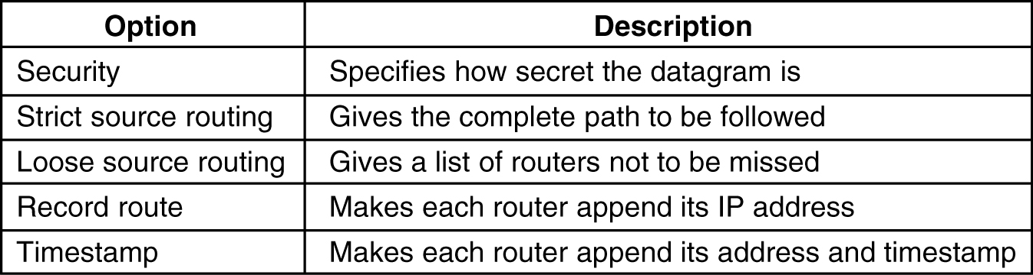
The IP Protocol
Each begins with a 1-byte code identifying the option.
Some options are followed by a 1-byte option length field, and then one or more data bytes.
The Options field is padded out to a multiple of four bytes.
Originally, five options were defined
Some of the IP options.

Slide 60
The IP Protocol
Security option tells how secret the information is.
In theory, a military router might use this field to specify not to route through certain countries the military considers to be ''bad guys.''
In practice, all routers ignore it
Strict source routing option
gives the complete path from source to destination as a sequence of IP addresses.
The datagram is required to follow that exact route.
It is most useful for system managers to send emergency packets when the routing tables are corrupted, or for making timing measurements.

Slide 61
The IP Protocol
Loose source routing option
requires the packet to traverse the list of routers specified, and in the order specified, but it is allowed to pass through other routers on the way.
Normally, this option would only provide a few routers, to force a particular path.
For example, to force a packet to go west instead of east
This option is most useful when political or economic considerations dictate passing through or avoiding certain countries.

Slide 62
The IP Protocol
Record route option
tells the routers along the path to append their IP address to the option field.
This allows system managers to track down bugs in the routing algorithms
When the ARPANET was first set up, no packet ever passed through more than 9 routers, so 40 bytes of option was ample.
As mentioned above, now it is too small.
Timestamp option
Similar to the Record route option,
except that in addition to recording its 32-bit IP address, each router also records a 32-bit timestamp.
This option, too, is mostly for debugging routing algorithms.

Slide 63
IPv6
Major goals were:
1. Support billions of hosts, even with inefficient address space allocation.
2. Reduce the size of the routing tables.
3. Simplify the protocol, to allow routers to process packets faster.
4. Provide better security (authentication and privacy) than current IP.
5. Pay more attention to type of service, particularly for real-time data.
6. Aid multicasting by allowing scopes to be specified.
7. Make it possible for a host to roam without changing its address.
8. Allow the protocol to evolve in the future.
9. Permit the old and new protocols to coexist for years.

Slide 64
IPv6
IPv6 represents a big advance is in security.
Authentication and privacy are key features of new IP.
These were later added to IPv4
more attention has been paid to quality of service
with the growth of multimedia on the Internet, the sense of urgency is greater
Main IPv6 Header is shown in the next slide
Version field is always 6 for IPv6 (4 for IPv4 )
During the transition period from IPv4, router will be able to examine this field to tell what kind of packet they have

Slide 65
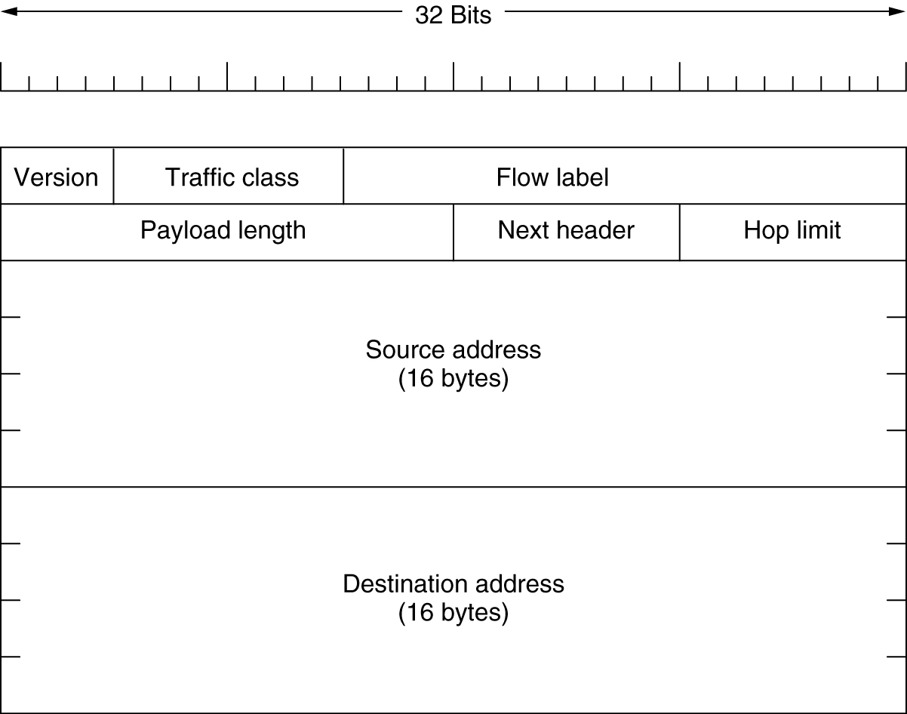
The Main IPv6 Header
The IPv6 fixed header (required).

Slide 66
IPv6
Traffic class field
used to distinguish between packets with different real-time delivery requirements.
A field designed for this purpose has been in IP since the beginning, but it has been only periodically implemented by routers.
Experiments are now underway to determine how best it can be used for multimedia delivery
Flow label field
also still experimental
but will be used to allow a source and destination to set up a pseudo-connection with particular properties and requirements.

Slide 67
IPv6
Payload length field
tells how many bytes follow the 40-byte main header
The name was changed from the IPv4 Total length field because the meaning was changed slightly:
the 40 header bytes are no longer counted as part of the length

Slide 68
IPv6
Next header field
there can be additional (optional) extension headers.
This field tells which of the (currently) six extension headers follow this one.
Hop limit field
used to keep packets from living forever.
same as the Time to live field in IPv4, namely, a field that is decremented on each hop.
In theory, in IPv4 it was a time in seconds, but no router used it that way
so the name was changed to reflect the way it is actually used

Slide 69
IPv6
Source address and Destination address fields
16-byte addresses
They are written as eight groups of four hexadecimal digits with colons between the groups
8000:0000:0000:0000:0123:4567:89AB:CDEF

Slide 70
IPv6
Since many addresses will have many zeros inside them, three optimizations have been authorized.
leading zeros within a group can be omitted, so 0123 can be written as 123.
one or more groups of zero bits can be replaced by a pair of colons
The above address now becomes
8000::123:4567:89AB:CDEF

Slide 71
IPv6
Compare the IPv4 header with the IPv6 header
IHL field is gone because the IPv6 header has a fixed length.
Protocol field was taken out because the Next header field tells what follows the last IP header (e.g., a UDP or TCP segment).
All the fields relating to fragmentation were removed because IPv6 takes a different approach to fragmentation
hosts are expected to dynamically determine the datagram size to use.
router that is unable to forward it sends back an error message
This message tells the host to break up all future packets to that destination
Checksum field is gone because calculating it greatly reduces performance (data link layer and transport layers normally have their own checksums)

Slide 72
IP Addresses
Every host and router on the Internet has an IP address, which encodes its network number and host number.
The combination is unique:
no two machines on the Internet have the same IP address.
All IP addresses are 32 bits long & are used in the Source address and Destination address fields of IP packets.
It is important to note that an IP address does not actually refer to a host.
It really refers to a network interface, so if a host is on two networks, it must have two IP addresses.
However, in practice, most hosts are on one network and thus have one IP address.

Slide 75
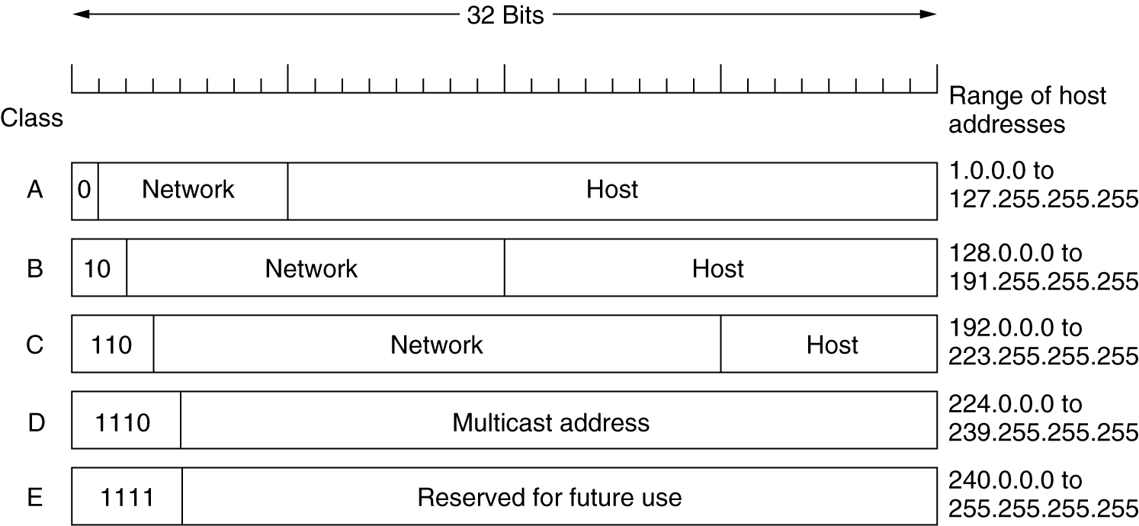
IP Addresses
For several decades, IP addresses were divided into the five categories. This allocation was called classful addressing
IP address formats.

Slide 78
Tutorial

Slide 79
IP Addresses
Network numbers are managed by a nonprofit corporation called ICANN (Internet Corporation for Assigned Names and Numbers) to avoid conflicts
Network addresses, which are 32-bit numbers, are usually written in dotted decimal notation.
In this format, each of the 4 bytes is written in decimal, from 0 to 255.
For example, the 32-bit hexadecimal address C0290614 is written as 192.41.6.20
The lowest IP address is 0.0.0.0 and the highest is 255.255.255.255.
The values 0 and -1 (all 1s) have special meanings
value 0 means this network or this host.
value of -1 is used as a broadcast address to mean all hosts on the indicated network

Slide 80
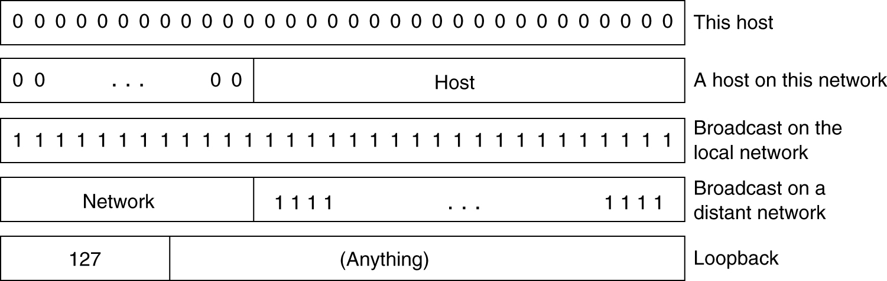
IP Addresses
Special IP addresses.

Slide 81
IP Addresses - classless addressing or Classless Interdomain Routing (CIDR)
A classless addressing system Or Classless interdomain routing (CIDR) is an improved IP addressing system.
In this, the block of IP addresses is assigned dynamically based on certain rules.
A classless addressing system Or Classless interdomain routing (CIDR) is represented in terms of the block.
A block is a group of IP addresses.
Notation of a classless addressing system Or Classless interdomain routing (CIDR):
p.q.r.s /n,
where p.q.r.s represents the IP address, and n represents the mask bits.

Slide 82
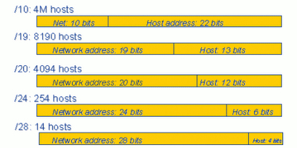
IP Addresses
Classless addressing
Classless addressing uses a variable number of bits for the network and host portions of the address.

Slide 83
Subnets
All the hosts in a network must have the same network number.
This property of IP addressing can cause problems as networks grow
The problem is the rule that a single class A, B, or C address refers to one network, not to a collection of LANs.
As more and more organizations ran into this situation, a small change was made to the addressing system to deal with it.
The solution is to allow a network to be split into several parts for internal use but still act like a single network to the outside world.

Slide 84
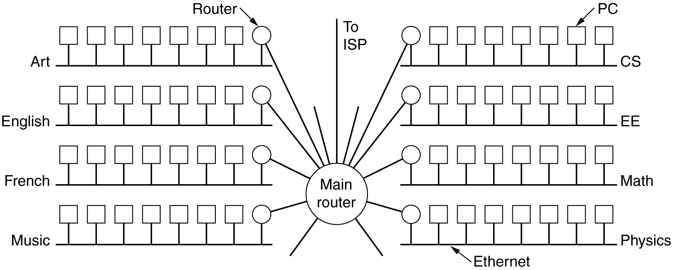
Subnets
A campus network consisting of LANs for various departments.

Slide 85
Subnets
parts of the network (in this case, Ethernets) are called subnets.
When a packet comes into the main router, how does it know which subnet (Ethernet) to give it to?
One way would be to have a table with 65,536 entries in the main router telling which router to use for each host on campus.
This idea would work, but it would require a very large table in the main router and a lot of manual maintenance as hosts were added, moved, or taken out of service.
Instead, a different scheme was invented.

Slide 86
Subnets
Basically, instead of having a single class B address with 14 bits for the network number and 16 bits for the host number,
some bits are taken away from the host number to create a subnet number.
For example, if the university has 35 departments,
it could use a 6-bit subnet number and a 10-bit host number,
allowing for up to 64 (2⁶) Ethernets,
each with a maximum of 1022 hosts (0 and -1 are not available)

Slide 87
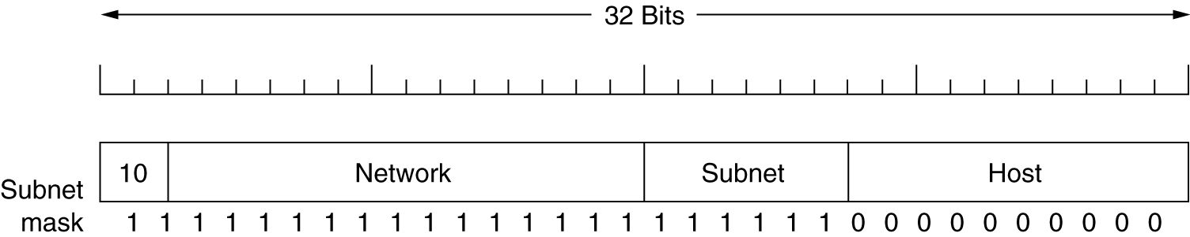
Subnets
To implement subnetting, the main router needs a subnet mask that indicates the split between network + subnet number and host, as shown in Fig
Fig: A class B network subnetted into 64 subnets.
Subnet masks are also written in dotted decimal notation, with the addition of a slash followed by the number of bits in the network + subnet part.
For the example of Fig., the subnet mask can be written as 255.255.252.0.
An alternative notation is /22 to indicate that the subnet mask is 22 bits long.

Slide 88
Subnets
Outside the network, the subnetting is not visible
So, allocating a new subnet does not require contacting ICANN or changing any external databases.
For eg:
the first subnet might use IP addresses starting at 130.50.4.1;
the second subnet might start at 130.50.8.1;
the third subnet might start at 130.50.12.1; and so on
To see why the subnets are counting by fours, note that the corresponding binary addresses are as follows:
Subnet 1: 10000010 00110010 000001|00 00000001
Subnet 2: 10000010 00110010 000010|00 00000001
Subnet 3: 10000010 00110010 000011|00 00000001
vertical bar (|) shows the boundary between the subnet number and the host number.

Slide 89
Subnets
How subnets work:
How to deal with the network:
Each router has a table listing
some number of (network, 0) IP addresses and
some number of (this-network, host) IP addresses.
(network, 0) IP addresses tells how to get to distant networks.
(this-network, host) tells how to get to local hosts.
Associated with each table is the network interface to use to reach the destination
When an IP packet arrives, its destination address is looked up in the routing table.
If the packet is for a distant network, it is forwarded to the next router on the interface given in the table.

Slide 90
Subnets
If it is a local host (e.g., on the router's LAN), it is sent directly to the destination.
If the network is not present, the packet is forwarded to a default router with more extensive tables.
This algorithm means that each router only has to keep track of other networks and local hosts, not (network, host) pairs
This greatly reducing the size of the routing table.
When subnetting is introduced, the routing tables are changed, adding entries of the form (this-network, subnet, 0) and (this-network, this-subnet, host).
Thus, a router on subnet k knows how to get to all the other subnets and also how to get to all the hosts on subnet k.
It does not have to know the details about hosts on other subnets.

Slide 91
Subnets
all that needs to be changed is
to have each router do a Boolean AND with the network's subnet mask to get rid of the host number and look up the resulting address in its tables (after determining which network class it is).
For example, a packet addressed to 130.50.15.6 and arriving at the main router is ANDed with the subnet mask 255.255.252.0/22 to give the address 130.50.12.0.
10000010 00110010 00001111 00000110 AND
11111111 11111111 11111100 00000000
10000010 00110010 00001100 00000000 (Subnet 3)
This address is looked up in the routing tables to find out which output line to use to get to the router for subnet 3.
Subnetting thus reduces router table space by creating a three-level hierarchy consisting of network, subnet, and host.

Slide 92
Tutorial
A network on the Internet has a subnet mask of 255.255.240.0. What is the maximum number of hosts it can handle?
Subnet Mask : - 255.255.240.0
11111111.11111111.11110000.00000000
Netid | hostid |
It is a class B network. For a class B network, the upper 16 bits form the network address and lower 16 bits are subnet and host fields.
Of the lower 16 bits most significant 4 bits are 1111.This leaves 12 bits for the host number.
So,4096(2¹²) host address exists.
That is, Actual host addresses are- 4096
But, First and Last address are special so the maximum number of addresses that can be used as host address =4096-2=4094

Slide 93
Tutorial
How do you subnet the Class C IP address 195.1.1.0 so as to have 10 subnets with a maximum of 12 hosts in each subnet.
Current mask= 255.255.255.0
Bits needs for 10 subnets =4 =2⁴ =16 possible subnets
Bits needs for 12 hosts = 4 = 2⁴ = 16-2=14 possible hosts.
So our mask in binary =11110000= 240 decimal
Final Mask =255.255.255.240

Slide 94
3. Write the IP address 135.1.1.25 mask 255.255. 248.0 in CIDR(Classless Inter Domain Routing) notation
Decimal 248 =11111000 binary which means that 5 bits of this octet are used for the subnet.
Now add the 16 bits 255.255. and we have 21 bits.
So we write:135.1.1.25/21

Slide 95
Internet Control Protocols
In addition to IP, which is used for data transfer, the Internet has several control protocols used in the network layer, including ICMP, ARP, RARP, BOOTP, and DHCP
ICMP - Internet Control Message Protocol:
The operation of the Internet is monitored closely by the routers.
When something unexpected occurs, the event is reported by the ICMP
ICMP is also used to test the Internet.
About a dozen types of ICMP messages are defined. The most important ones are listed in Fig.
Each ICMP message type is encapsulated in an IP packet.

Slide 96
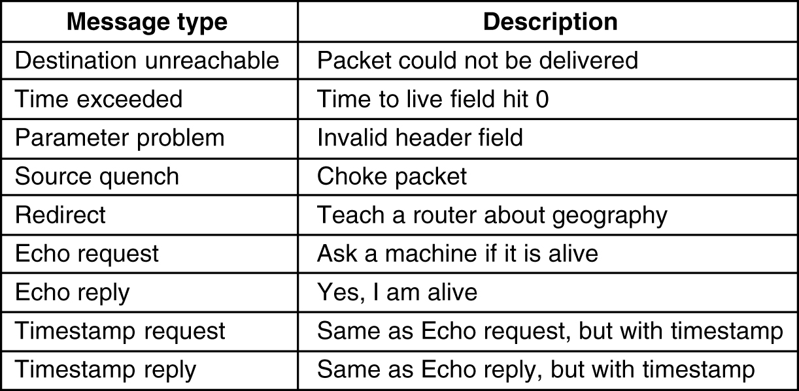
Internet Control Message Protocol
5-61
The principal ICMP message types.

Slide 97
Internet Control Protocols
DESTINATION UNREACHABLE message
used when the subnet or a router cannot locate the destination or when a packet with the DF bit cannot be delivered because a ''small-packet'' network stands in the way
TIME EXCEEDED message
sent when a packet is dropped because its counter has reached zero.
PARAMETER PROBLEM message
indicates that an illegal value has been detected in a header field.
This problem indicates a bug in the sending host's IP software or possibly in the software of a router transited.

Slide 98
Internet Control Protocols
SOURCE QUENCH message
used to block hosts that were sending too many packets.
When a host received this message, it was expected to slow down.
It is rarely used any more because when congestion occurs, these packets tend to add more fuel to the fire.
Congestion control in the Internet is now done largely in the transport layer
REDIRECT message
used when a router notices that a packet seems to be routed wrong.
It is used by the router to tell the sending host about the probable error.

Slide 99
Internet Control Protocols
ECHO and ECHO REPLY messages
used to see if a given destination is reachable and alive.
Upon receiving the ECHO message, the destination is expected to send an ECHO REPLY message back.
TIMESTAMP REQUEST and TIMESTAMP REPLY messages
similar, except that the arrival time of the message and the departure time of the reply are recorded in the reply.
This facility is used to measure network performance

Slide 100
Internet Control Protocols
ARP - The Address Resolution Protocol
IP addresses cannot actually be used for sending packets because the data link layer hardware does not understand Internet addresses.
Most hosts at companies and universities are attached to a LAN by an interface board that only understands LAN addresses.
For example, every Ethernet board comes equipped with a 48-bit Ethernet address.
Manufacturers of Ethernet boards request a block of addresses from a central authority to ensure that no two boards have the same address
The boards send and receive frames based on 48-bit Ethernet addresses.
They know nothing at all about 32-bit IP addresses.

Slide 101
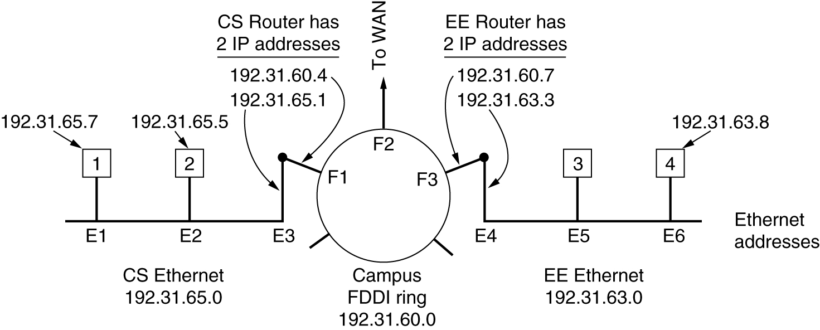
ARP - The Address Resolution Protocol
Three interconnected /24 networks: two Ethernets and an FDDI ring.

Slide 102
Internet Control Protocols
how a user on host 1 sends a packet to a user on host 2.
Let us assume the sender knows the name of the intended receiver, possibly something like xyz@cs.uni.edu
The first step is to find the IP address for host 2, known as cs.uni.edu.
This lookup is performed by the Domain Name System (DNS) which returns the IP address for host 2 (192.31.65.5).
upper layer software on host 1 now builds a packet with 192.31.65.5 in the Destination address field and gives it to the IP software to transmit.
The IP software can look at the address and see that the destination is on its own network but it needs some way to find the destination's Ethernet address .

Slide 103
Internet Control Protocols
One solution
to have a configuration file somewhere in the system that maps IP addresses onto Ethernet addresses.
While this solution is certainly possible, for organizations with thousands of machines, keeping all these files up to date is an error-prone, time-consuming job.
Better solution
to output a broadcast packet onto the Ethernet asking: Who owns IP address 192.31.65.5?
The broadcast will arrive at every machine on Ethernet 192.31.65.0, and each one will check its IP address.
Host 2 alone will respond with its Ethernet address (E2).
The protocol used for asking this question and getting the reply is called ARP (Address Resolution Protocol)
Almost every machine on the Internet runs it.

Slide 104
Mapping Logical to Physical Address: ARP
Process Involved:
>>When a host/router sends a IP datagram(packet)through physical network to the receiver, the sender needs the physical address of the receiver. Normally the logical (IP) address of Receiver is obtained from the DNS if the sender is the host or it is found in a routing table if the sender is a router.
>>The IP datagram from the sender must be encapsulated in a frame to be able to pass through the physical network. This means that the sender needs the physical address of the receiver.
>>The host or the router sends an ARP query packet. The packet includes the physical and IP addresses of the sender and the IP address of the receiver.
>>As the sender does not know the physical address of the receiver, the query is broadcast over the network.

Slide 106
>>Every host or router on the network receives and processes the ARP query packet, but only the intended recipient recognizes its IP address and sends back an ARP response packet.
The response packet contains the recipient's IP and physical addresses. The packet is unicast directly to the inquirer by using the physical address received in the query packet.
Cache Memory
Using ARP is inefficient if system A needs to broadcast an ARP request for each IP packet it needs to send to system B. It could have broadcast the IP packet itself.
ARP can be useful if the ARP reply is cached (kept in cache memory for a while) because a system normally sends several packets to the same destination.
A system that receives an ARP reply stores the mapping in the cache memory and keeps it for 20 to 30 minutes unless the space in the cache is exhausted. Before sending an ARP request, the system first checks its cache to see if it can find the mapping.

Slide 107
ARP Packet Structure

Slide 108
Different Cases

Slide 109
Internet Control Protocols
RARP - Reverse Address Resolution Protocol
Given an Ethernet address, what is the corresponding IP address?
This problem occurs when a diskless workstation is booted.
Such a machine will normally get the binary image of its OS from a remote file server.
But how does it learn its IP address?
RARP allows a newly-booted workstation to broadcast its Ethernet address and say: My 48-bit Ethernet address is 14.04.05.18.01.25.
Does anyone out there know my IP address?
The RARP server sees this request, looks up the Ethernet address in its configuration files, and sends back the corresponding IP address.

Slide 110
Internet Control Protocols
Disadvantage of RARP
uses a destination address of all 1s (limited broadcasting) to reach the RARP server.
Such broadcasts are not forwarded by routers
So, a RARP server is needed on each network
To overcome this problem, BOOTP was invented .

Slide 111
Internet Control Protocols
BOOTP - bootstrap protocol
BOOTP uses UDP messages, which are forwarded over routers.
It also provides a diskless workstation with additional information, including
IP address of the file server holding the memory image,
IP address of the default router, and
subnet mask to use.

Slide 112
Internet Control Protocols
Serious problem with BOOTP
Requires manual configuration of tables mapping IP address to Ethernet address.
When a new host is added to a LAN, it cannot use BOOTP until an administrator has assigned it an IP address and entered its (Ethernet address, IP address) into the BOOTP configuration tables by hand.
To eliminate this error-prone step, BOOTP was extended and given a new name: DHCP (Dynamic Host Configuration Protocol)

Slide 113
Internet Control Protocols
DHCP - Dynamic Host Configuration Protocol
DHCP allows both manual IP address assignment and automatic assignment.
In most systems, it has largely replaced RARP and BOOTP.
Like RARP and BOOTP, DHCP is based on the idea of a special server that assigns IP addresses to hosts asking for one.
This server need not be on the same LAN as the requesting host.
Since the DHCP server may not be reachable by broadcasting, a DHCP relay agent is needed on each LAN

Slide 114
Internet Control Protocols
To find its IP address, a newly-booted machine broadcasts a DHCP DISCOVER packet.
The DHCP relay agent on its LAN captures all DHCP broadcasts.
When it finds a DHCP DISCOVER packet, it sends the packet as a unicast packet to the DHCP server, possibly on a distant network.
The only piece of information the relay agent needs is the IP address of the DHCP server.

Slide 115
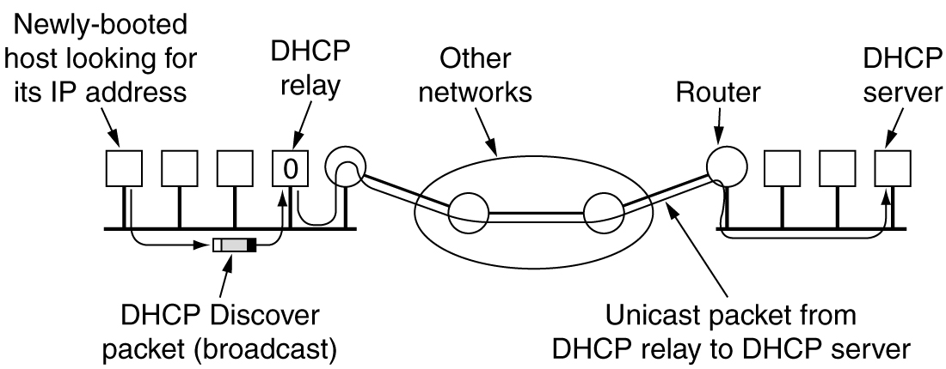
Dynamic Host Configuration Protocol
Operation of DHCP.

Slide 116
Internet Control Protocols
Issue that arises with automatic assignment of IP addresses from a pool
how long an IP address should be allocated.
If a host leaves the network and does not return its IP address to the DHCP server, that address will be permanently lost.
After a period of time, many addresses may be lost.
To prevent that from happening, IP address assignment may be for a fixed period of time, a technique called leasing.
Just before the lease expires, the host must ask the DHCP for a renewal.
If it fails to make a request or the request is denied, the host may no longer use the IP address it was given earlier.

Slide 117
Internet Multicasting
Ability to send to a large number of receivers simultaneously
Eg:
transmitting stock quotes to multiple brokers and
handling digital conference telephone calls
IP supports multicasting using class D addresses
Each class D address identifies a group of hosts
28 bits are available for identifying groups, so over 250 million groups can exist at the same time.
When a process sends a packet to a class D address, a best-efforts attempt is made to deliver it to all the members of the group addressed, but no guarantees are given
some members may not get the packet

Slide 118
Internet Multicasting
Two kinds of group addresses are supported:
permanent addresses and
temporary addresses .
permanent group is always there and does not have to be set up.
Each permanent group has a permanent group address
Some examples of permanent group addresses are:
224.0.0.1 All systems on a LAN
224.0.0.2 All routers on a LAN
224.0.0.5 All OSPF routers on a LAN
224.0.0.6 All designated OSPF routers on a LAN

Slide 119
Internet Multicasting
Temporary groups must be created before they can be used.
A process can ask its host to join a specific group.
It can also ask its host to leave the group.
When the last process on a host leaves a group, that group is no longer present on the host.
Each host keeps track of which groups its processes currently belong to.
Multicasting is implemented by special multicast routers
About once a minute, each multicast router sends a hardware (i.e., data link layer) multicast to the hosts on its LAN (address 224.0.0.1) asking them to report back on the groups their processes currently belong to.
Each host sends back responses for all the class D addresses it is interested in.

Slide 120
Internet Multicasting
These query and response packets use a protocol called IGMP (Internet Group Management Protocol),
which is vaguely analogous to ICMP.
It has only two kinds of packets:
query and response
each with a simple, fixed format containing some control information in the first word of the payload field and a class D address in the second word.
Multicast routing is done using spanning trees.
spanning tree of a connected, undirected graph, G is a tree that includes all of the vertices and some of the edges of G such that it becomes a tree, i.e, it contains no more cycles.

Slide 121
Internet Multicasting
Each multicast router exchanges information with its neighbors, using a modified distance vector protocol
In order for each one to construct a spanning tree per group covering all group members.
Various optimizations are used to prune the tree to eliminate routers and networks not interested in particular groups.
The protocol makes heavy use of tunneling to avoid bothering nodes not in a spanning tree.

